Slide 1
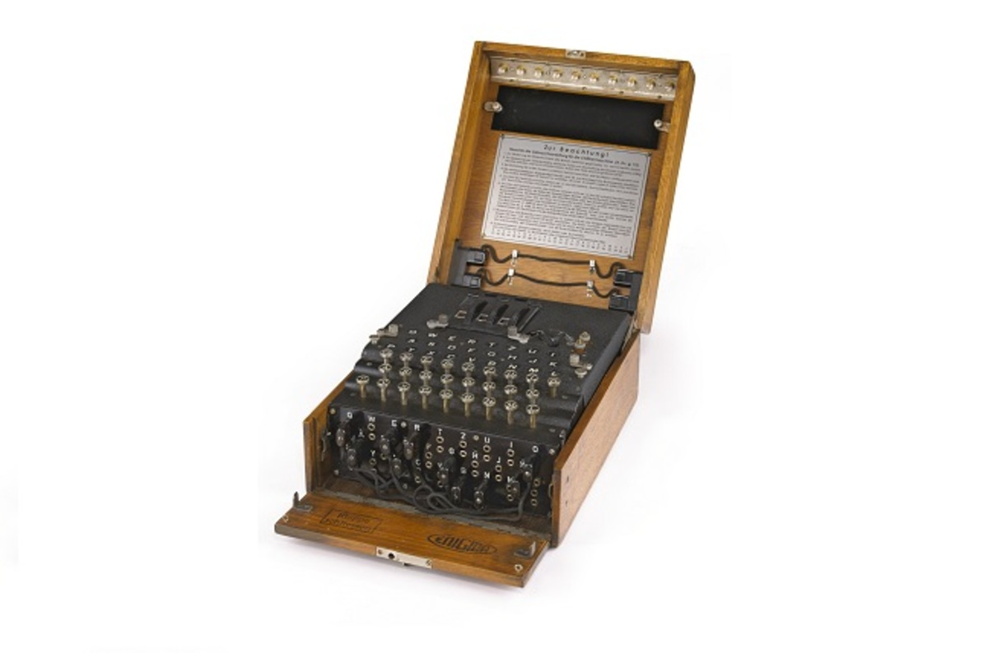

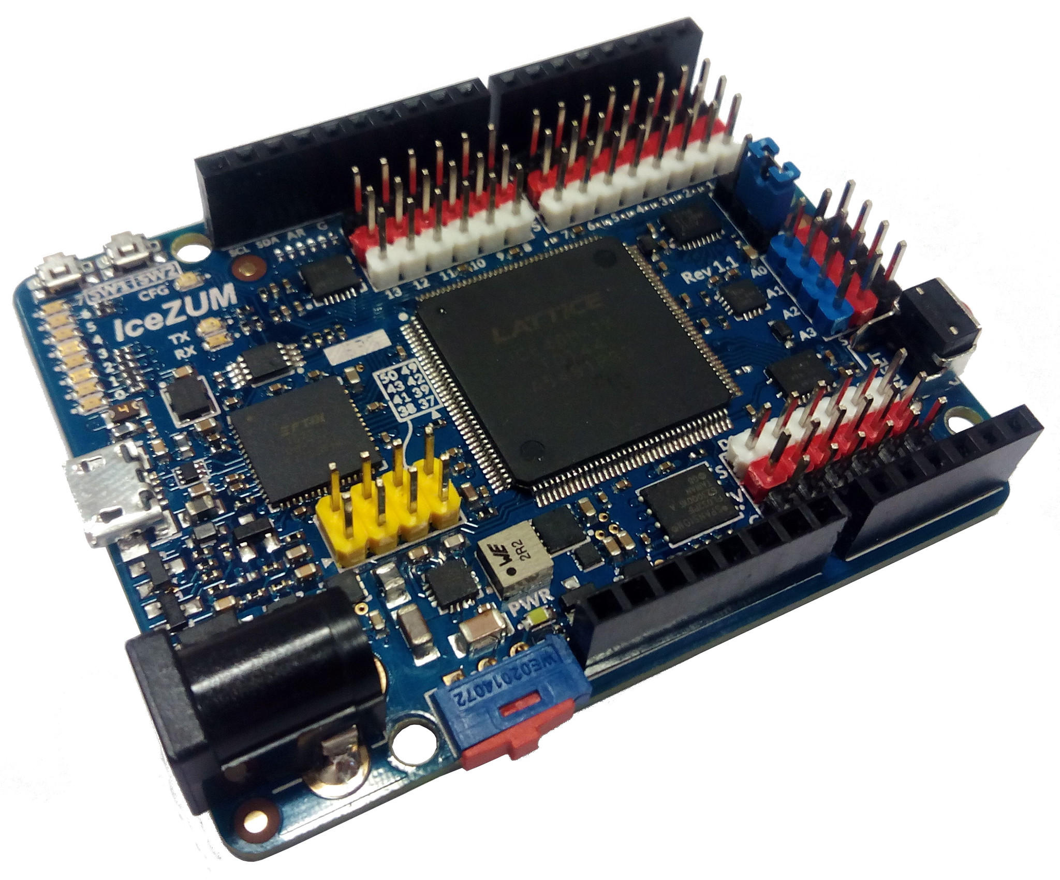


The enigma project
Creating an Enigma Machine inside an Open Source FGPA
Julián Caro Linares
jcarolinares@gmail.com
@jcarolinares

Slide 2
Cryptography
Greek kryptos “hidden” + graphia “to write”
“A secret message”

Slide 3
when we were just childs...
Hidden messages with family and friends
Secret languages
Invisible ink
Invisible friends
Humans need secrets, because they have feelings that can be harmed, but need to be said

Slide 4
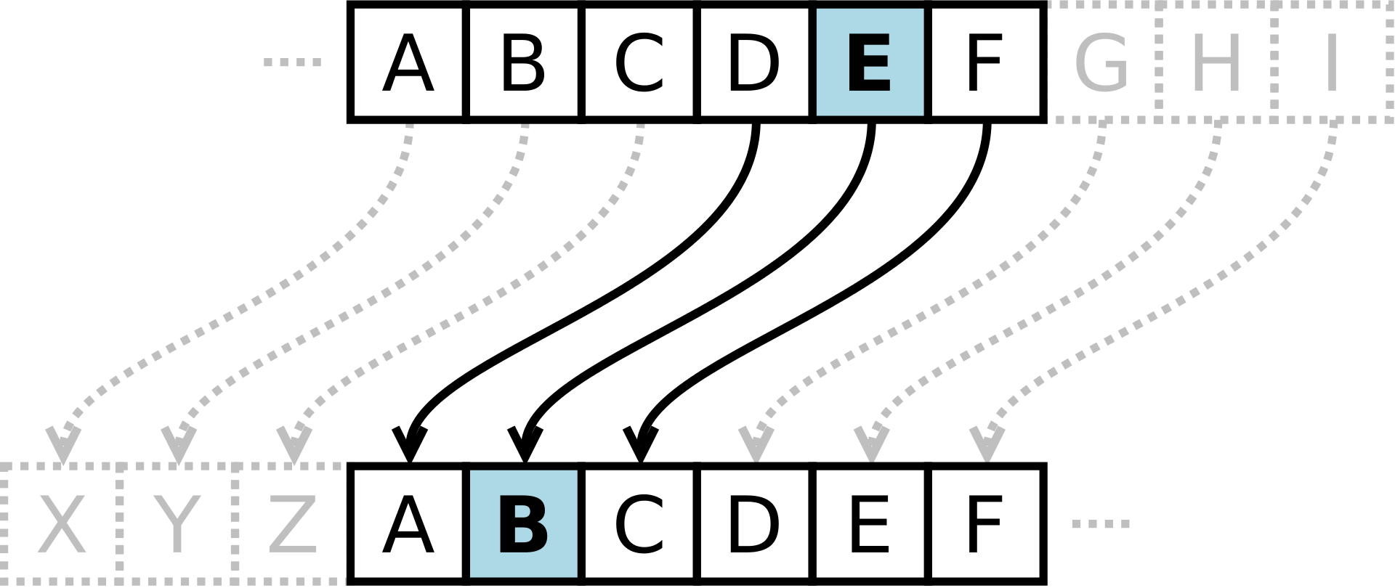
The Caesar Cipher

Slide 5
INFORMATION IS POWER

Slide 6



World War II

Slide 7
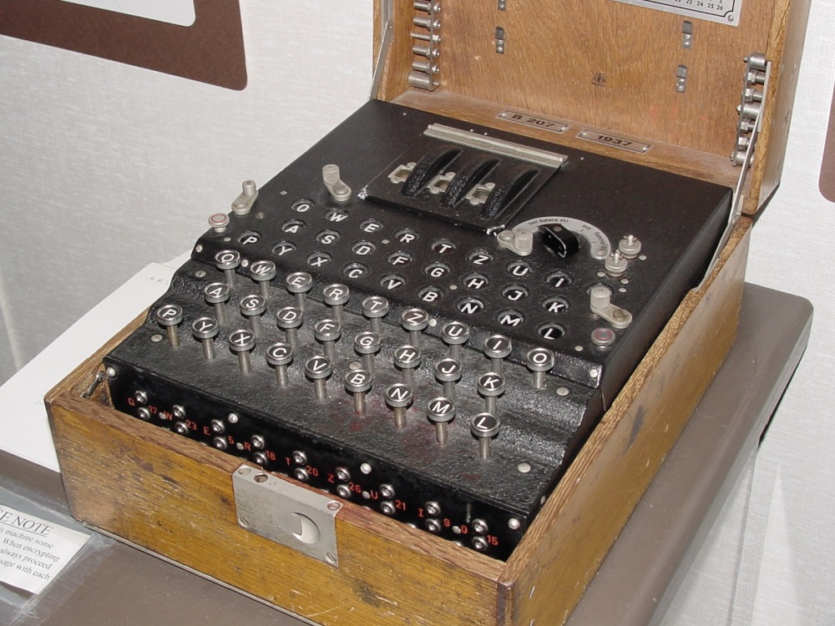
The Enigma Machine

Slide 8
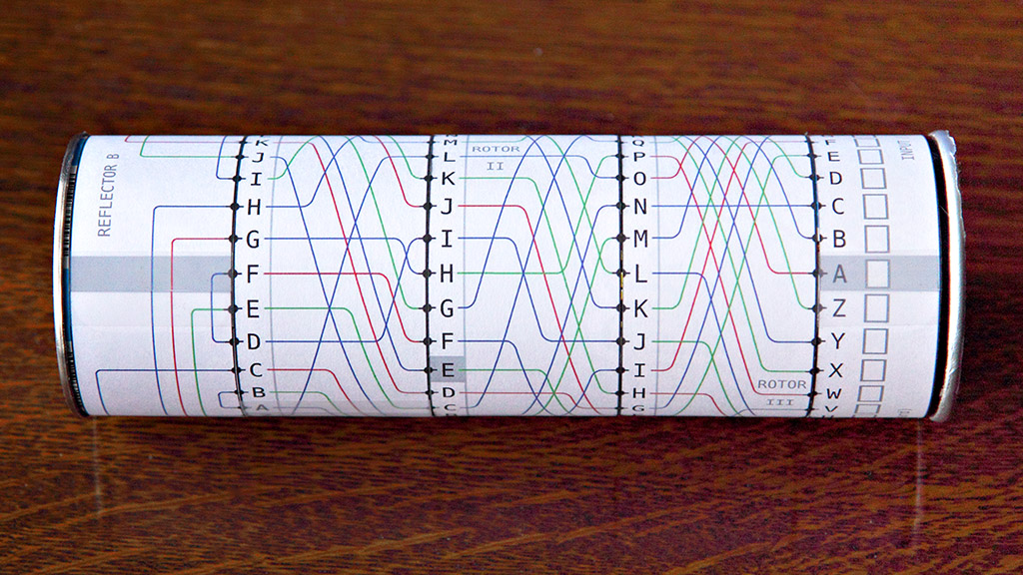
let’s write “hello”

Slide 9
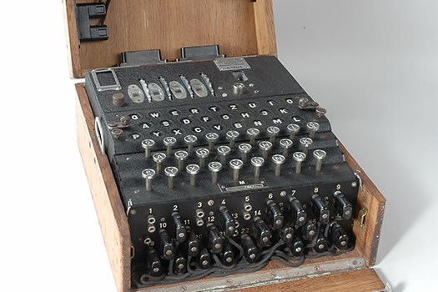
nazis improved enigma
Additional rotors for the Nazi’s Marine Army
Plugboard
Three rotors -> 26 × 26 × 26 = 17,576 combinations.
17,576 by six possible wheel orders gives 105,456 combinations
Plus a fourth rotor and a plugboard the number of combinations are:
3×10¹¹⁴ (~380 bits)

Slide 10
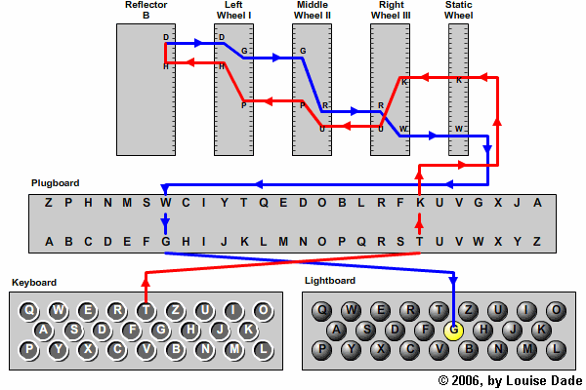
nazis improved enigma
A letter is never encrypted as itself

Slide 11
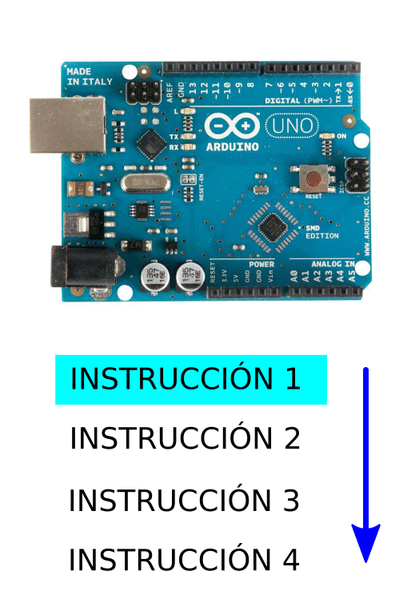
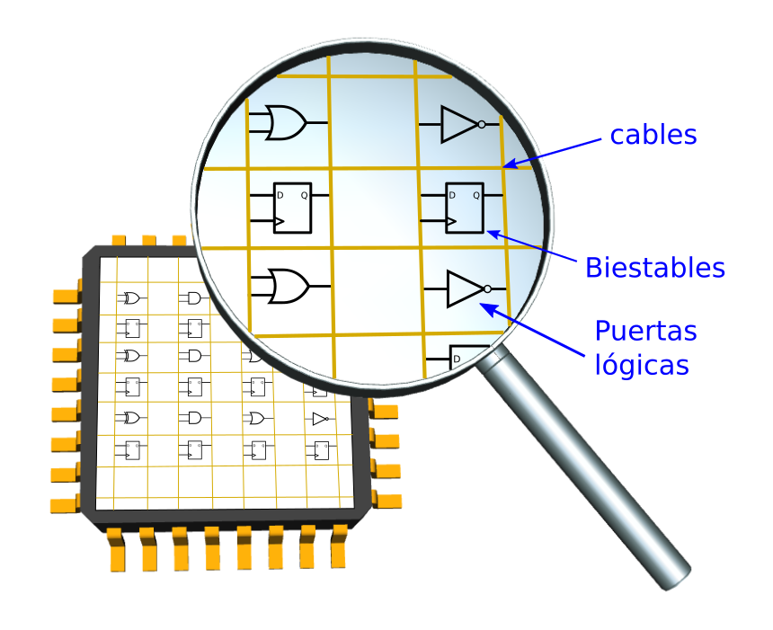
STOP!
Field Programmable Gate Array
what is an fpga?
Juan Gonzalez Gomez: https://github.com/Obijuan/digital-electronics-with-open-FPGAs-tutorial

Slide 12
fpgas are...
We are creating REAL circuits inside the FPGA. NO PROGRAMS HERE. JUST HARDWARE.
Each circuit is INDEPENDENT and all the circuits work in PARALLEL, just like real circuits because THEY ARE REAL.
If the circuit is well designed, it’s faster than its equivalent implementation in software. If not, probably it’s also faster.
You can make new circuits without the need of manufacture again the new circuit all the times that you want, in a matter of seconds.

Slide 13

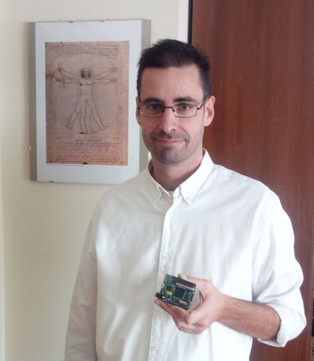

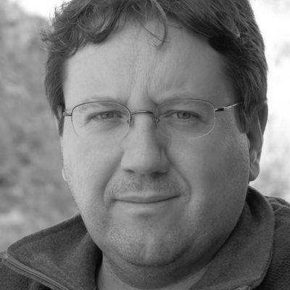
open source fpgas
Clifford Wolf
“The fucking master of the universe”
Project IceStorm

Slide 14
the enigma inside an fpga
Notes:
Show here the enigma developed

Slide 15
setup of icestudio and scriptcommunicator
https://github.com/FPGAwars/icestudio
https://github.com/szieke/ScriptCommunicator_serial-terminal
https://github.com/FPGAwars/Collection-Jedi
Notes:
Show here the enigma developed

Slide 16
let’s play with icestudio
Notes:
Show here the enigma developed

Slide 17
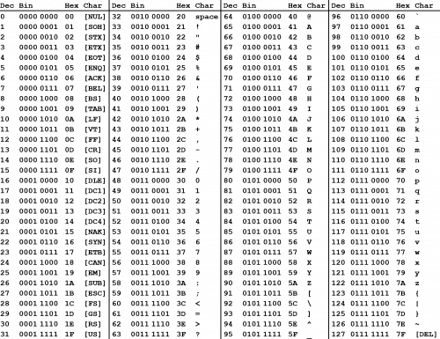
what is ascii
CASE SENSITIVE

Slide 18
verilog: describing hardware
Notes:
Show here the enigma developed

Slide 19
the caesar circuit
ENCRYPTION ROTOR
IN
LETTER
ALPHABET
CRYPT
OUT
LETTER
“b”
“a”
Alphabet and crypt change position depending of the Encryption/Decryption mode
Notes:
Show here the enigma developed

Slide 20
the caesar circuit
ENCRYPTION ROTOR
IN
LETTER
CRYPT
ALPHABET
OUT
LETTER
“a”
“b”
Alphabet and crypt change position depending of the Encryption/Decryption mode
Notes:
Show here the enigma developed

Slide 21
our first enigma with one rotor
Notes:
Show here the enigma developed

Slide 22
enigma with three motors
Notes:
Show here the enigma developed

Slide 23
THERE’S MORE...
Notes:
Show here the enigma developed

Slide 24

alan turing
He demonstrates that “The Entscheidungsproblem (decision problem)” cannot be resolve.
One of the founders of the Science of computation. He creates “The Turing Machine”. One of the first theoretical general purpose computer.
He broke the encryption of “The Enigma Machine” thanks to his talent and vision. He saves (and provoke) thousands of lives and reduce the WWII in more than two years.
Notes:
Show here the enigma developed

Slide 25
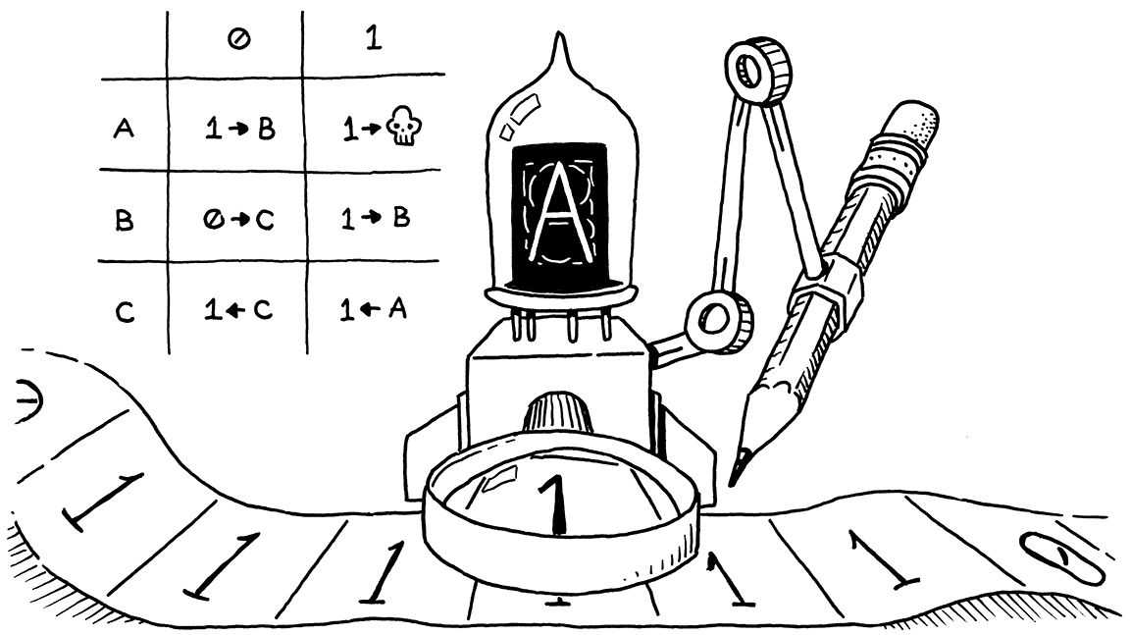
the turing machine
Notes:
Show here the enigma developed

Slide 26
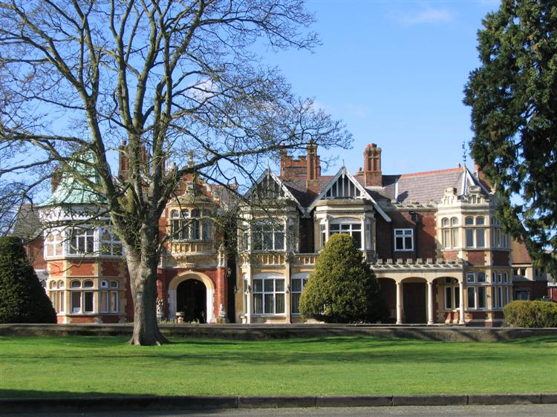
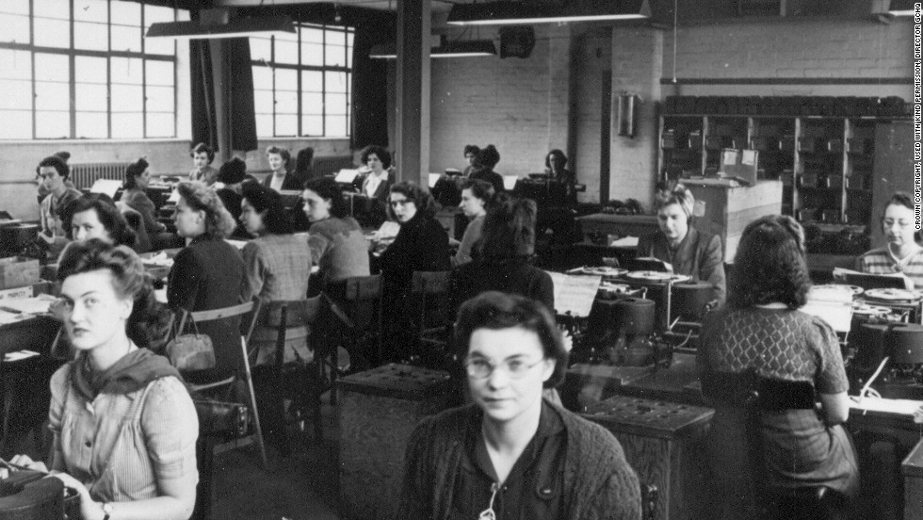
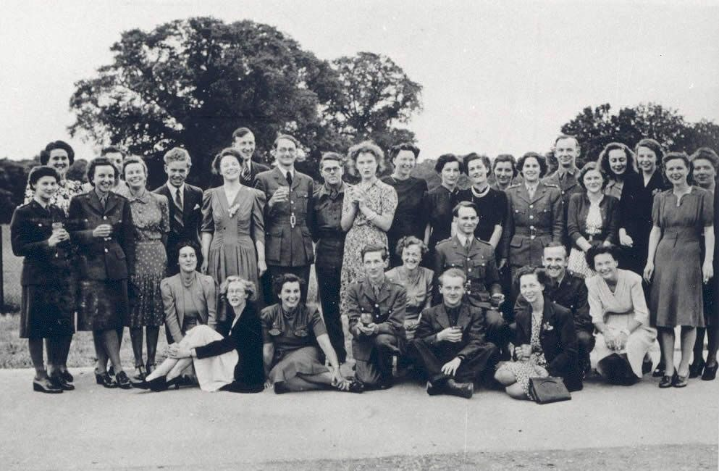
bletchey park
Notes:
Show here the enigma developed

Slide 27
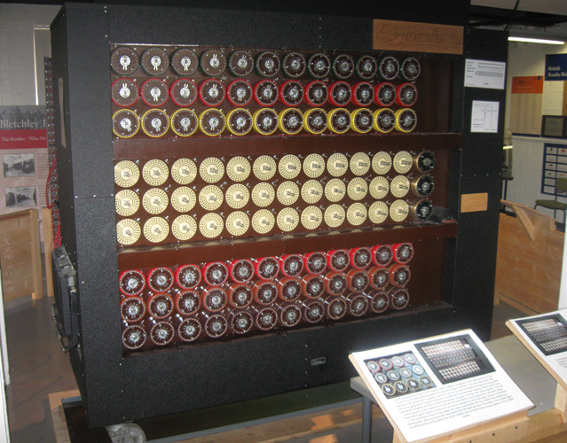
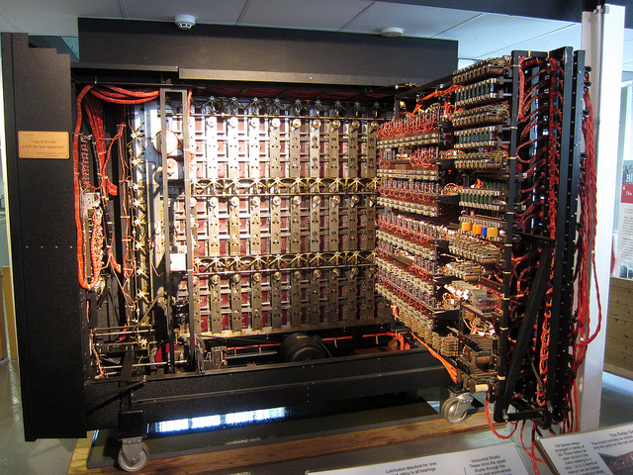
“the bomb”
Equivalent to 36 Enigma machines of three rotors
First version created by the Polish mathematician Marian Rejewski
Notes:
Show here the enigma developed

Slide 28
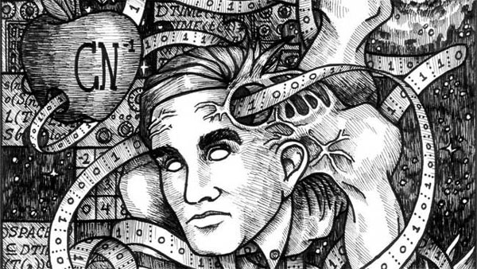
alan turing
8 June 1954
Notes:
Show here the enigma developed

Slide 29

The enigma project
Creating an Enigma Machine inside an Open Source FGPA
Julián Caro Linares
jcarolinares@gmail.com
@jcarolinares

